Slide 1
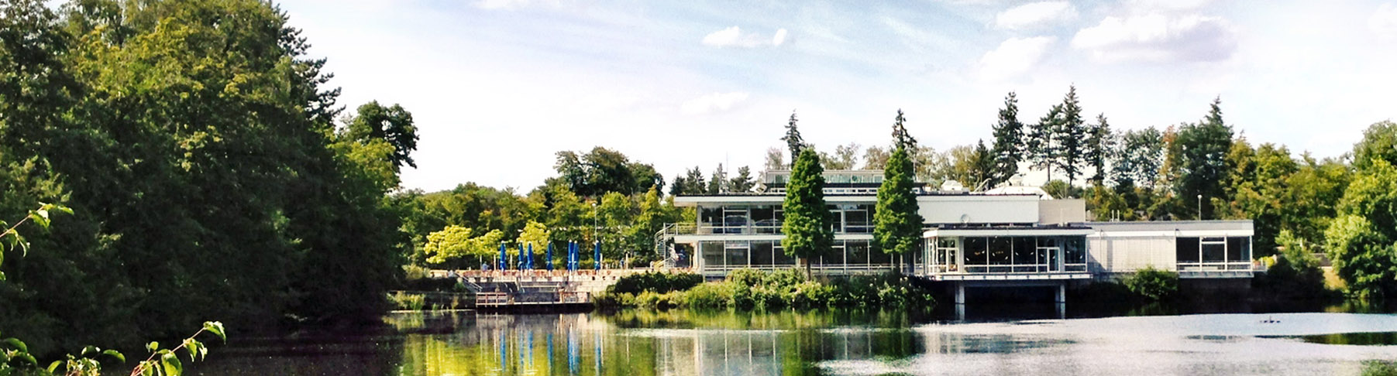
Structural causal models and diffusion models
Workings of causaldiffae
13.08.2025 I lado turmanidze

Slide 2
Structural Causal Models and Diffusion Models
Unlikely Alliance
Why Combine Structural Causal Models and Diffusion Models?
Interpretability: Integrating structural causal models (SCMs) with diffusion models aligns generative factors with meaningful, causal variables, making model behavior more transparent and controllable. This is vital in domains like physics, where understanding the effect of each variable is crucial.
Interventions with Limited Data: SCMs enable explicit interventions, allowing users to generate and analyze counterfactual scenarios. In fields with scarce data, such as experimental sciences, this means researchers can simulate the impact of changes or rare events, improving robustness and insight even when real-world data is limited.

Slide 3
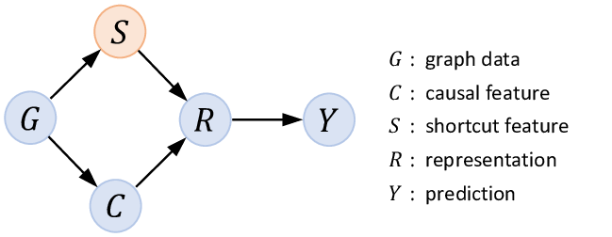
Structural Causal Models
SCMs for short
Traditional machine learning models often identify correlations between variables, but they do not inherently provide insights into whether one variable causes change in another.
By representing the variables involved within a directed acyclic graph (DAG), one can identify potential confounders and assess the direct effects of the medication on recovery.
That is exactly what SCMs do.
SCMs enable the analysis of counterfactual scenarios, which can answer questions of the form "What would have happened if...?".
Yongduo Sui et al. Deconfounded Training for Graph Neural Networks. December 2021.

Slide 4
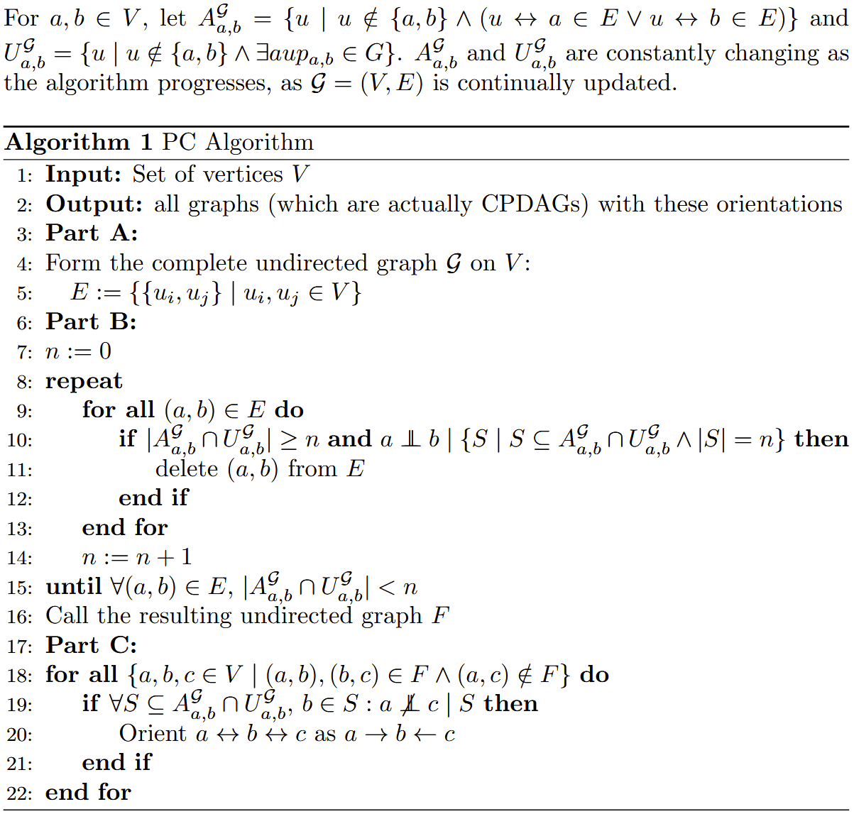
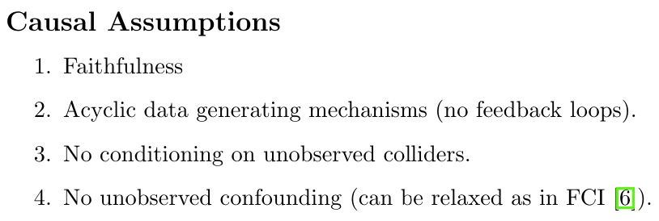
Structural causal models
Buildup to SCMs

Slide 5
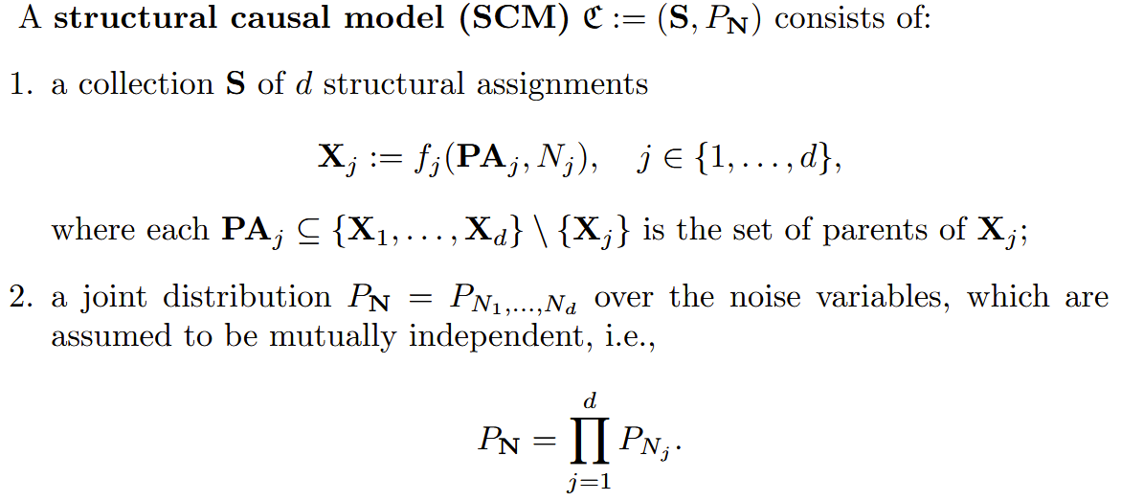
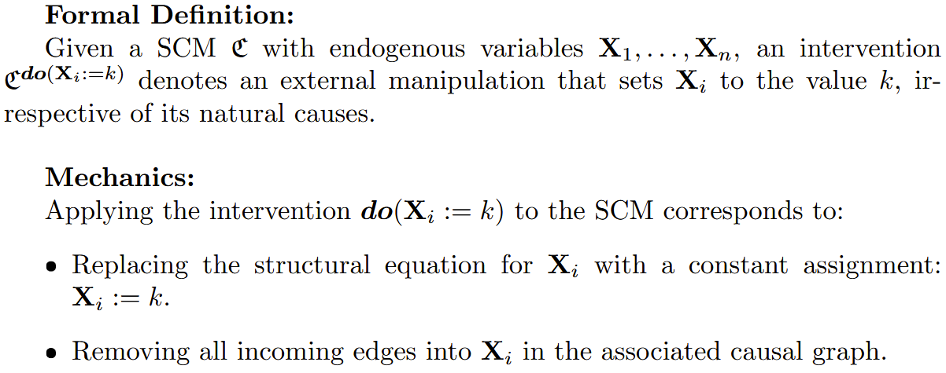
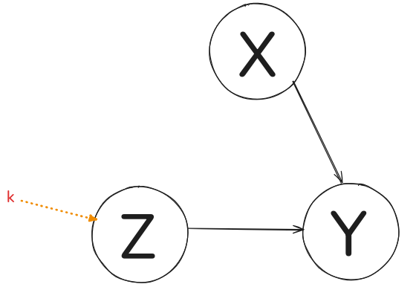
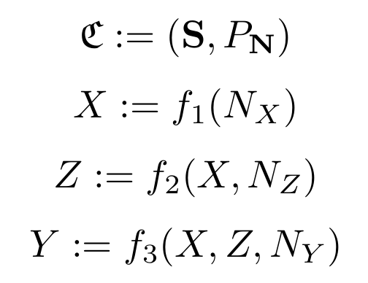
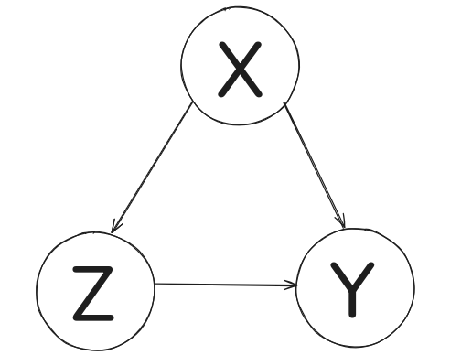

Structural causal models
Formal definition of SCMs and interventions

Slide 6
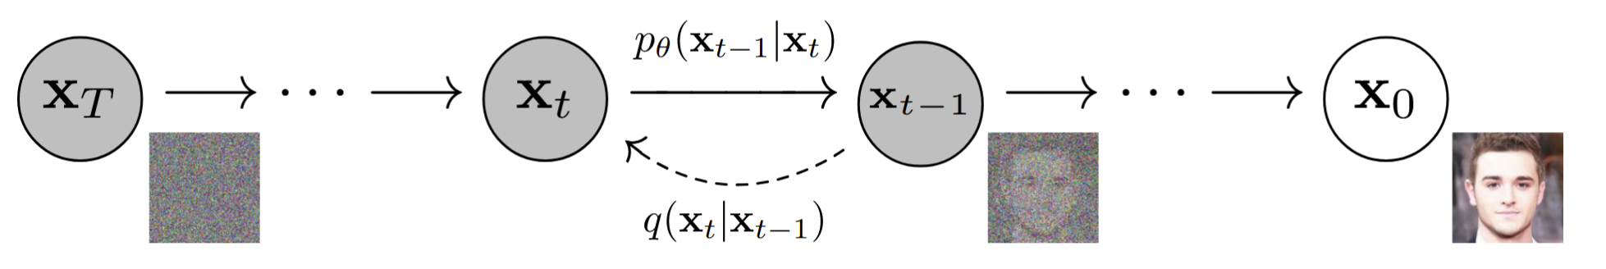
Diffusion
Powering most of today's image generation
Construct a chain of transformations instead of the single-step process used in the Variational Autoencoder (VAE). Analogous to the encoder and decoder architecture of VAEs, diffusion models involve forward and reverse processes(q and p, respectively).
Instead of relying on a single encoder to map data to a latent space and a single decoder to reconstruct the data, diffusion models use a sequence of T+1 steps, where each step incrementally adds or removes noise.
At each step, the transition distribution depends only on the immediate previous state, allowing the overall generation process to be decomposed into many simpler sub-tasks.
Ho et al. Denoising Diffusion Probabilistic Models, 2020.

Slide 7
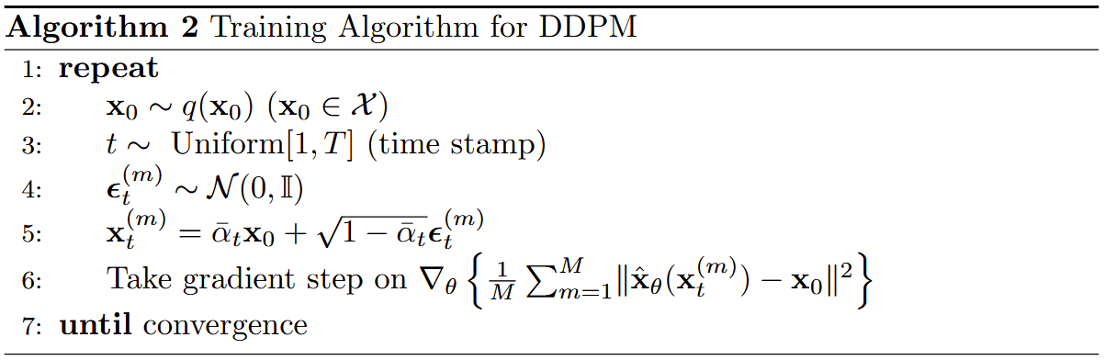
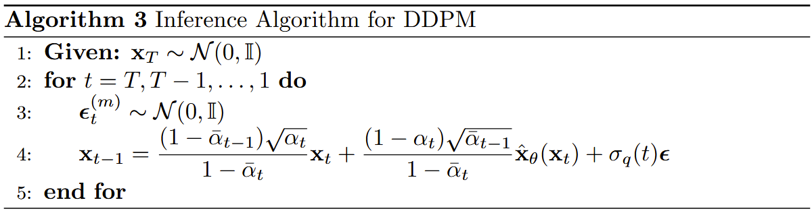
DENOISING DIFFUSION PROBABILISTIC MODELS
DDPMs for short

Slide 8
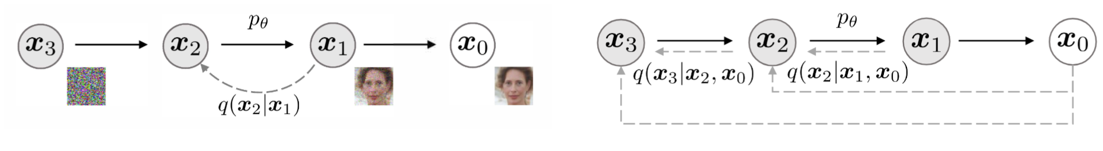
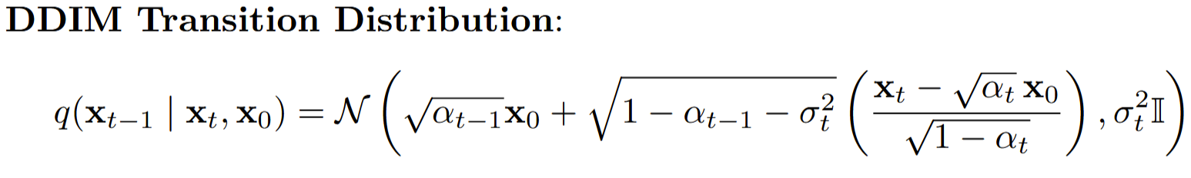

Denoising Diffusion Implicit models
An improvement over DDPM
A key drawback of DDPMs is their reliance on many iterations to generate high-fidelity samples.
As noted by Song et al. Denoising diffusion implicit models (International Conference on Learning Representations (ICLR), 2023), a DDPM would take more than 1,000 hours to generate 50K 256 x256 images on a standard GPU.
This inefficiency arises because the reverse diffusion process requires iterative denoising.
If the process intrinsically needs many steps to converge, generation will inherently be slow. Therefore, to accelerate computation, it is necessary to reduce the number of iterations.
Song et al. Denoising diffusion implicit models, International Conference on Learning Representations (ICLR), 2023.

Slide 9
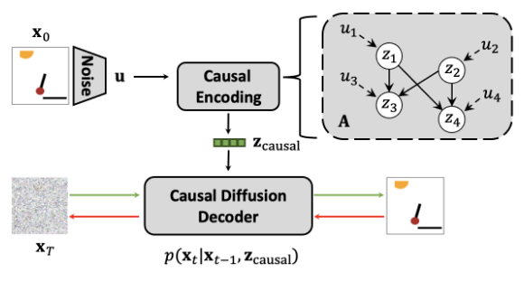
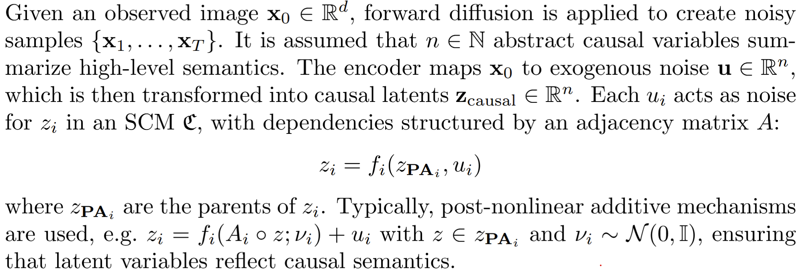
Causal Diffusion Autoencoders
Komanduri et al. Causal Diffusion Autoencoders: Toward Representation-Enabled Counterfactual Generation via Diffusion Probabilistic Models.
The authors aim to model causal relations among semantic latent variables in order to learn causal representations and enable counterfactual generation in DPMs. To this end, the authors propose CausalDiffAE, a framework for causal representation learning and controllable counterfactual generation in DPMs.
The main idea is to learn a causal representation using a stochastic encoder, and to model the relationships among latent variables by parameterizing causal mechanisms with neural networks.
Decoding and stochastic variation modeling are achieved using a conditional DDIM. This approach yields a compact, causally-relevant latent representation for reverse diffusion image synthesis.
By explicitly modeling causal relations in the latent space, counterfactual samples can be generated via interventions on the learned causal variables.
Komanduri et al. Causal Diffusion Autoencoders: Toward Representation-Enabled Counterfactual Generation via Diffusion Probabilistic Models. 2024

Slide 10
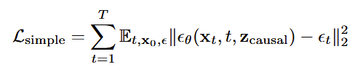
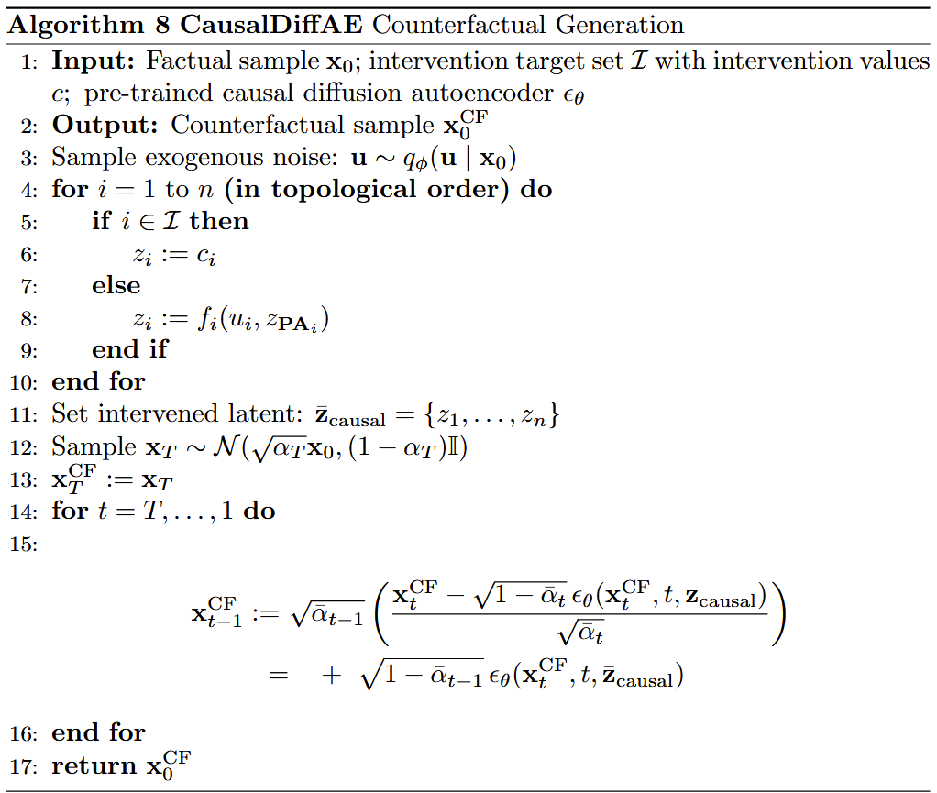
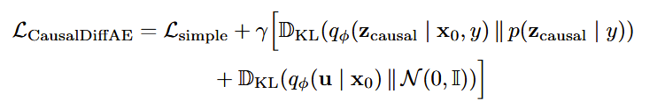
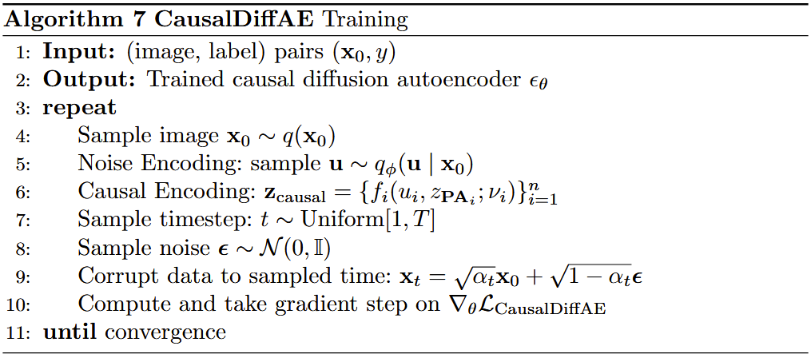
Causaldiffae

Slide 11
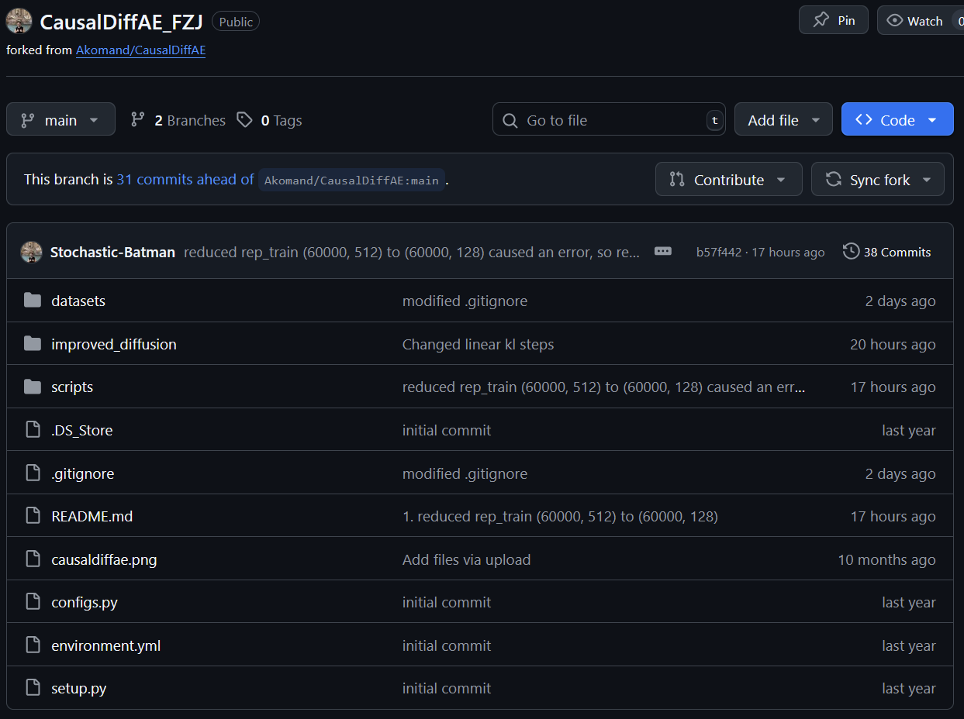
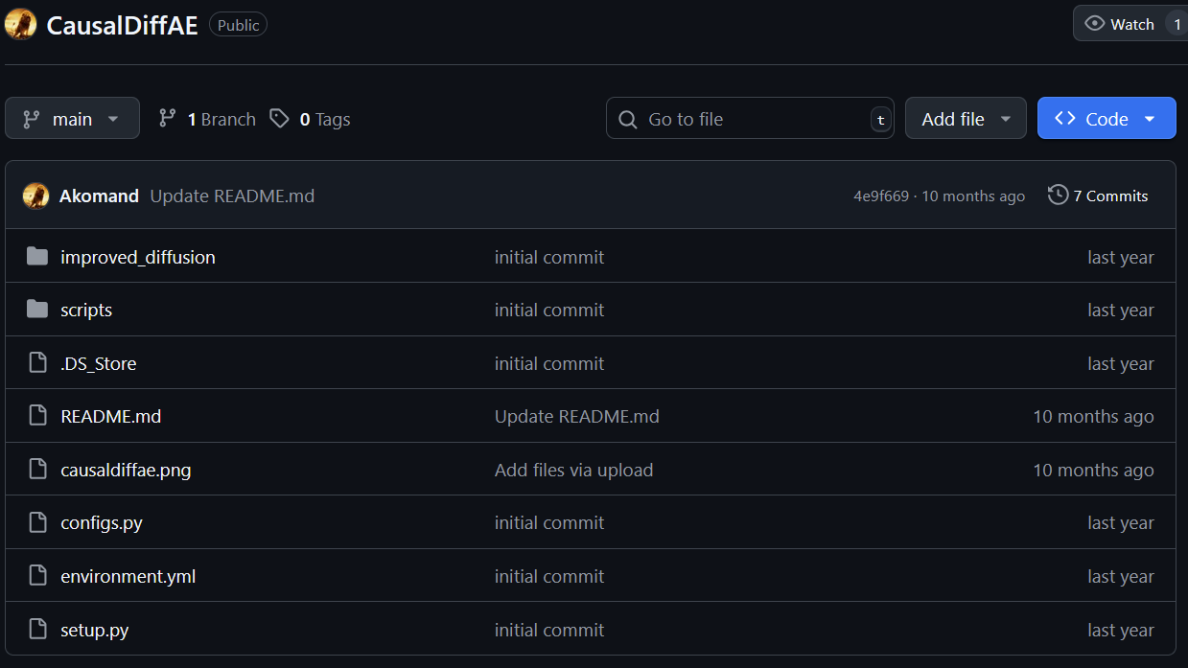
Source Code
Source code of CausalDiffAE paper (not working):
https://github.com/Akomand/CausalDiffAE.git
Source code of my fork (working only for MorphoMNIST):
https://github.com/Stochastic-Batman/CausalDiffAE_FZJ.git

Slide 12
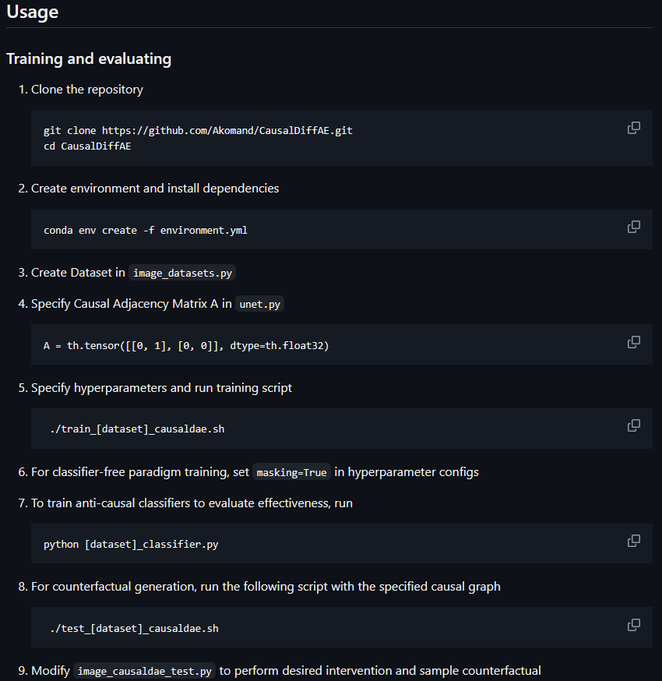
WHy fork it?
The original source code from the author has:
No instructions regarding data generation
LOTS of bugs
Redundant code
A minimal README.md that is more confusing than if you were to figure out how the code is supposed to work on your own
It uses other repositories for appropriate data generation, but there is no mention of that; you have to figure it out on your own
At one point in time, I thought it was better to just write the entire code from scratch... But Dr. Cao recommended trying to fix it, and it worked more and more, bit by bit.

Slide 13
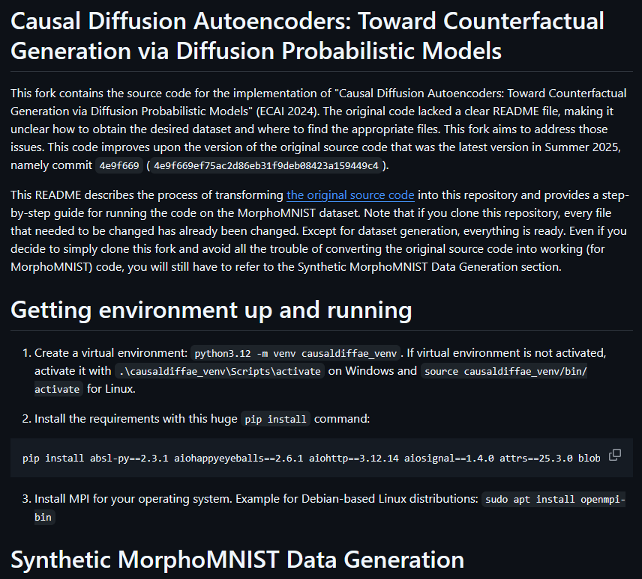
Why use my fork?
Clear README.md that transitions from original source code to working code (for MorphoMNIST).
Detailed walkthrough of every step, including data generation, code replacements, and parameter correction.
Except for data generation, if you clone the fork, you have everything already available.
Additional logging statements that are not included in README.md (as they are not crucial but desirable).
A little too long README.md, but it is what it's supposed to be.

Slide 14
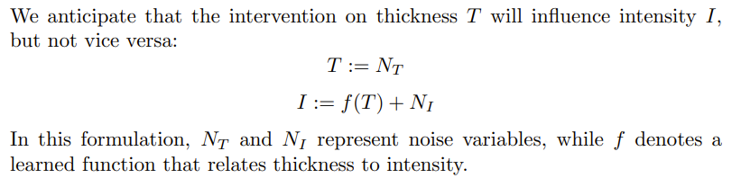
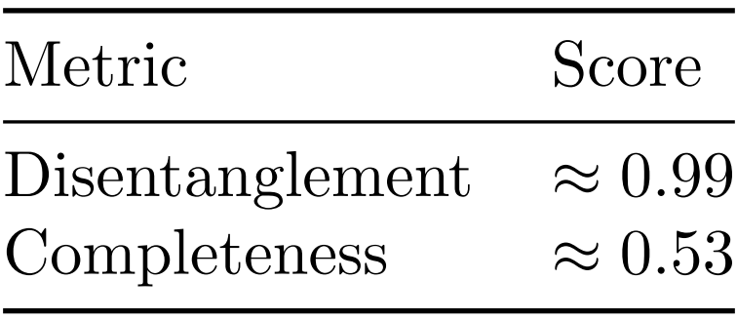
Experiments
Expectation and metrics
The higher the disentanglement score, the better; the same goes for completeness. However, since we only have thickness and intensity, a score of 0.53 is acceptable.

Slide 15
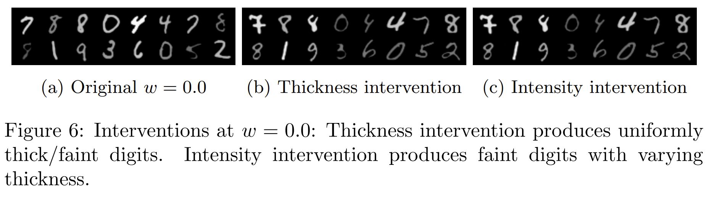
Experiment run for...
W = 0

Slide 16
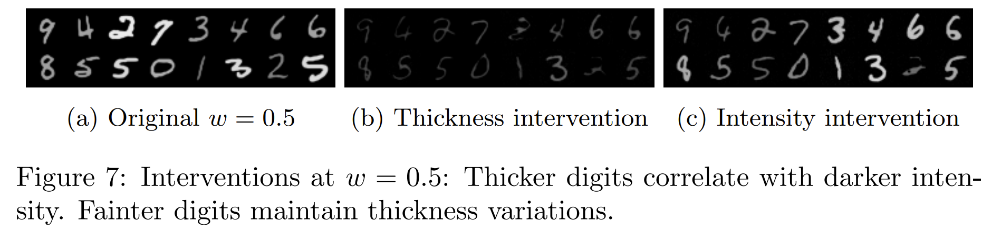
Experiment run for...
W = 0.5

Slide 17
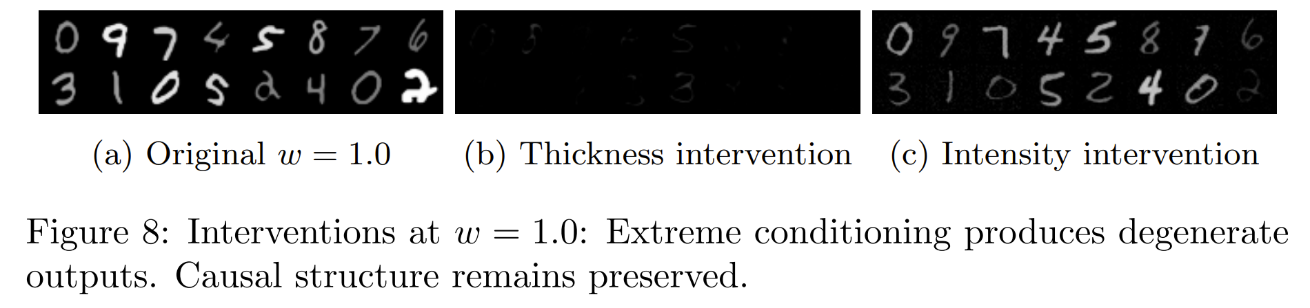
Experiment run for...
W = 1
w = 1 results in degeneration as latents exceed the training distribution support!

Slide 18
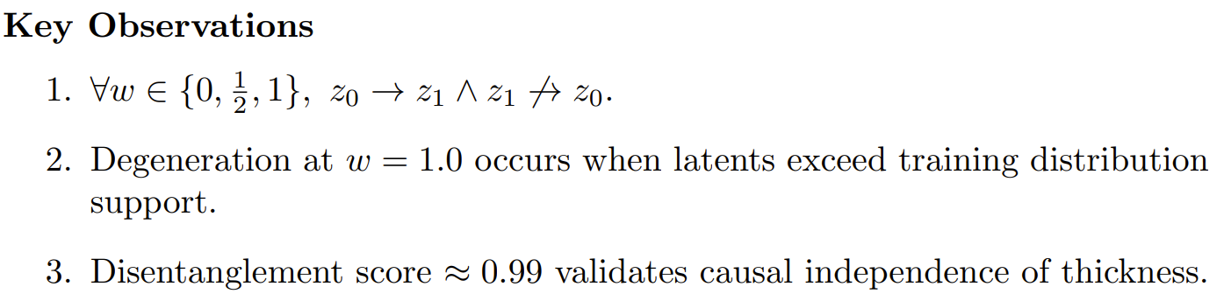
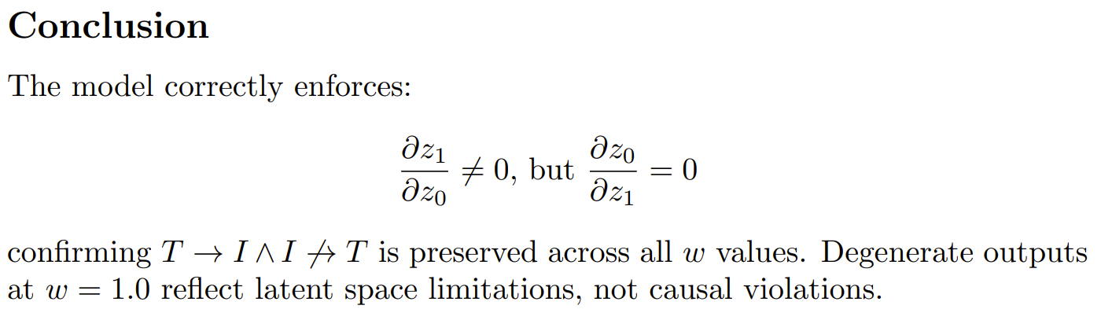
Key observations and conclusion

